Slide 1
Credit Customer Segmentation
With KMeans

Slide 2
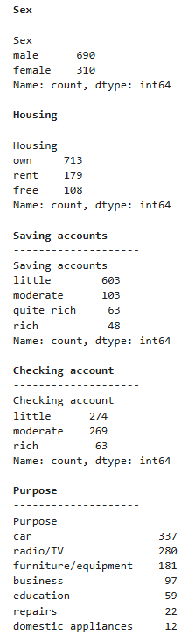
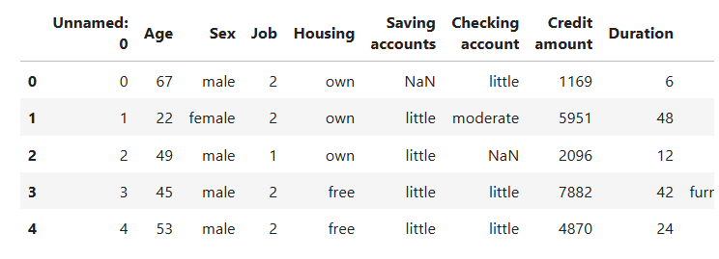
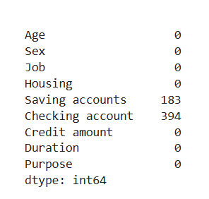
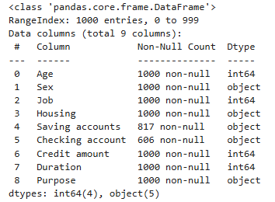
Data understanding
Count value categories every column
Delete the first column (0) because it only contains the index.
Checking Null value
Dataframe Info

Slide 3
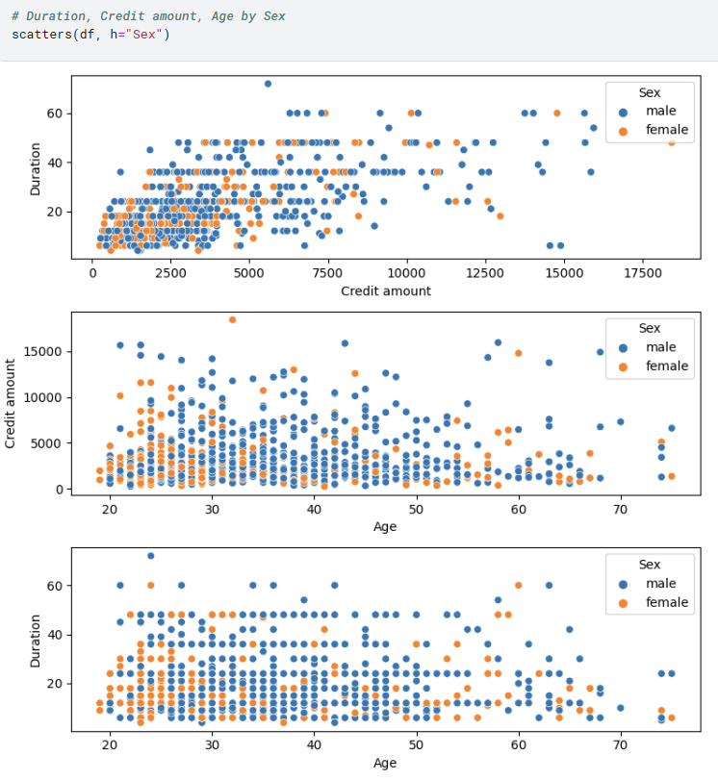
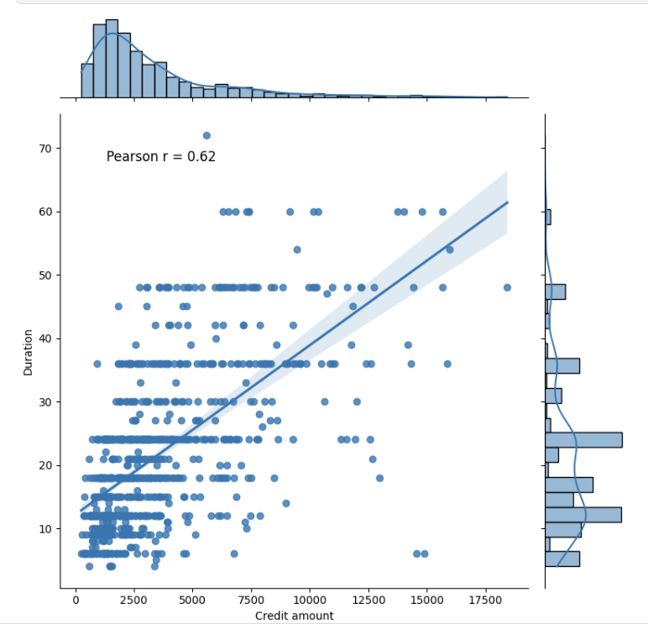
Explonatory data analysis
For the results of duration and credit amount on age, there is no significant correlation for both men and women.
While for the duration on the credit amount, there is a pattern that for smaller credit amounts, the duration tends to be shorter.
Furthermore, using linear correlation to further confirm it
Pearson r showing 0.62 means that there is a strong correlation between duration and credit amount.

Slide 4
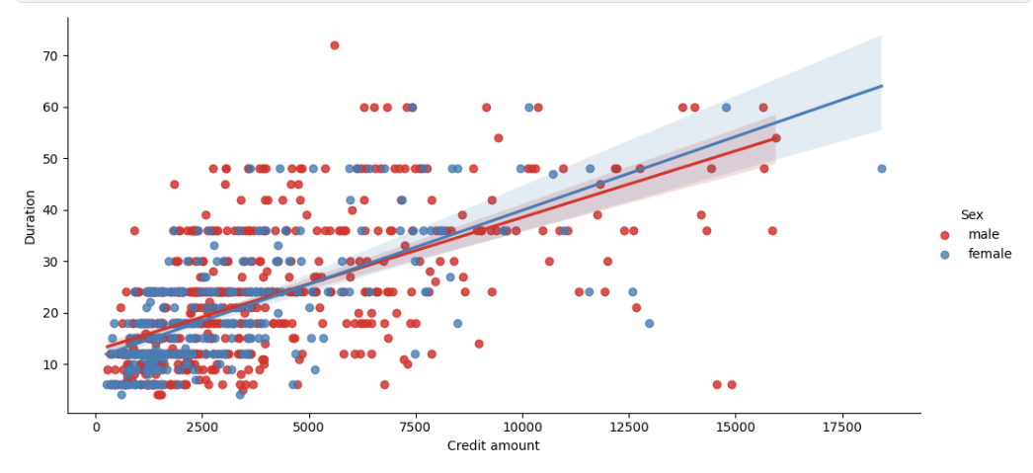
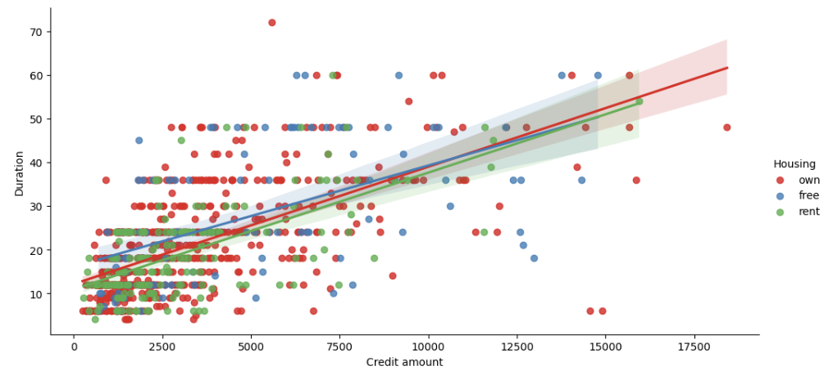
Explonatory data analysis
There is no significant difference between male and female credit owners
There is no significant difference between the categories of housing credit owners.

Slide 5
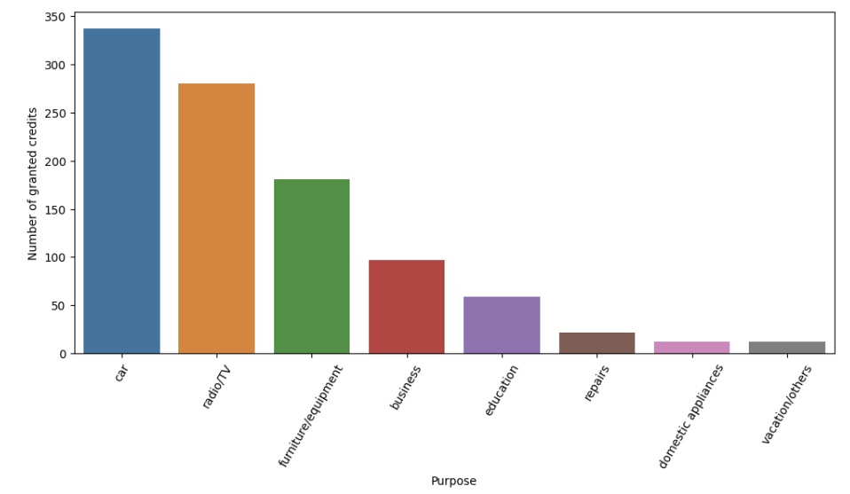
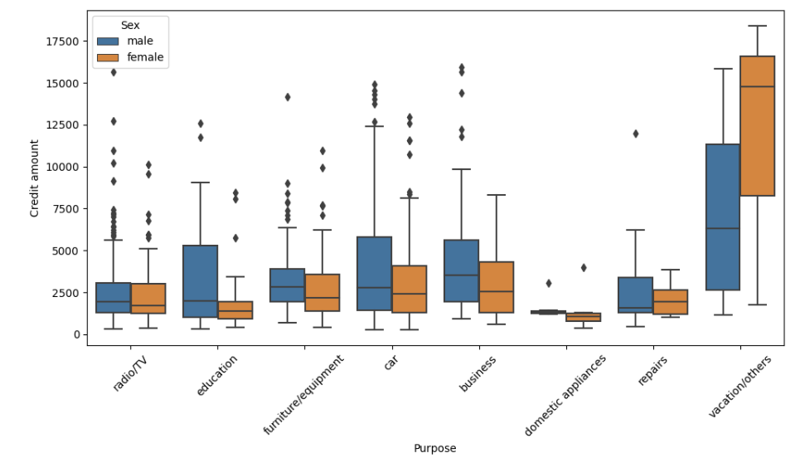
Explonatory data analysis
Top purpose of credit usage
Credit amount based on purpose for each sex category
The barplot shows that credit is mostly used for cars and TV/Radio.
The largest credit amount is used for vacation/others, while the smallest credit amount is used for domestic appliances.

Slide 6
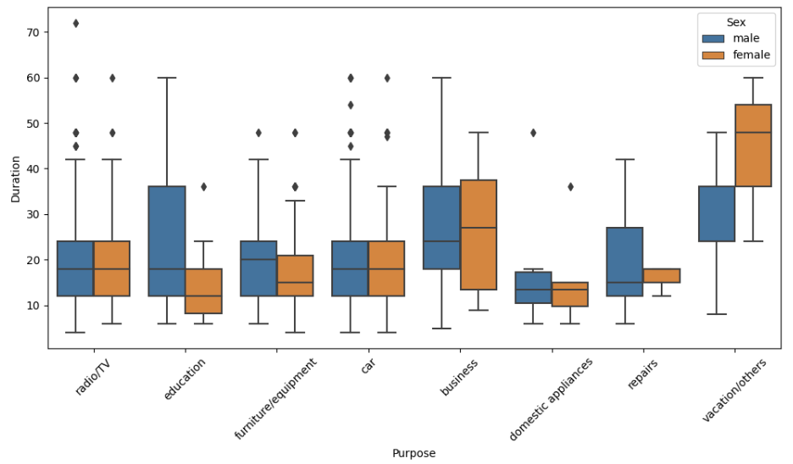
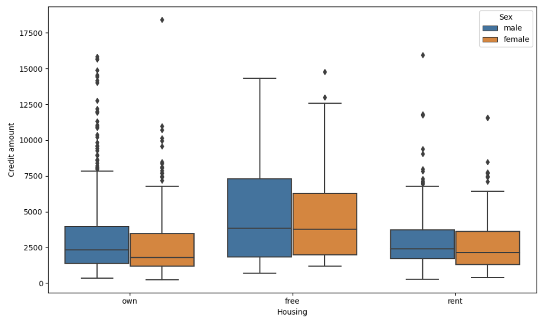
Explonatory data analysis
Total duration based on purpose for each sex category
Total credit amount based on housing for each sex category
The longest credit duration is used for vacation/others for female but not for male.
There is no significant difference for women and men for credit amount based on housing category.

Slide 7
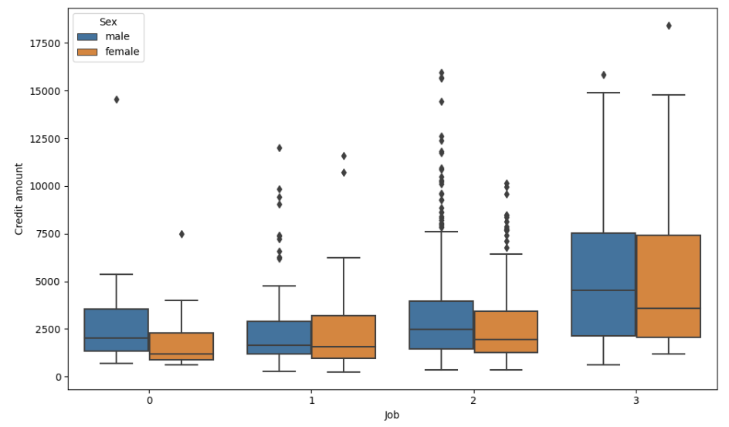
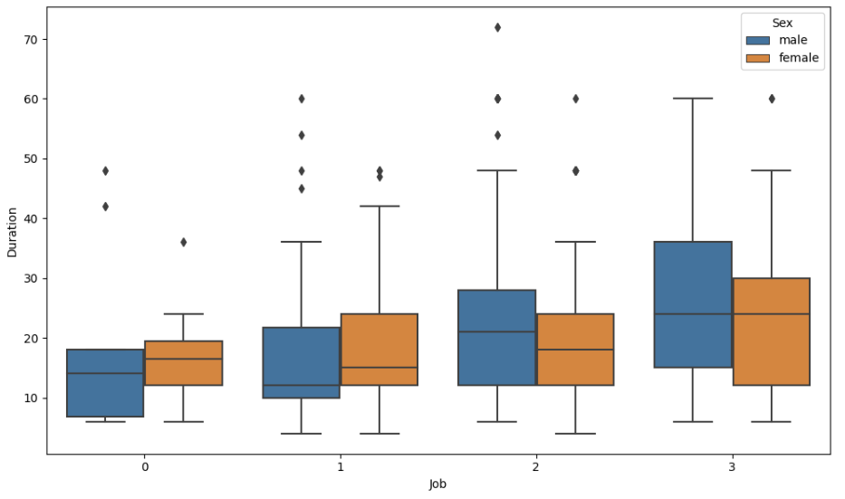
Explonatory data analysis
Credit amount based on job for each sex category
Total duration based on job for each sex category
Both male and female whose jobs are in category 3 or highly skilled tend to have slightly more credit amounts and longer durations.

Slide 8
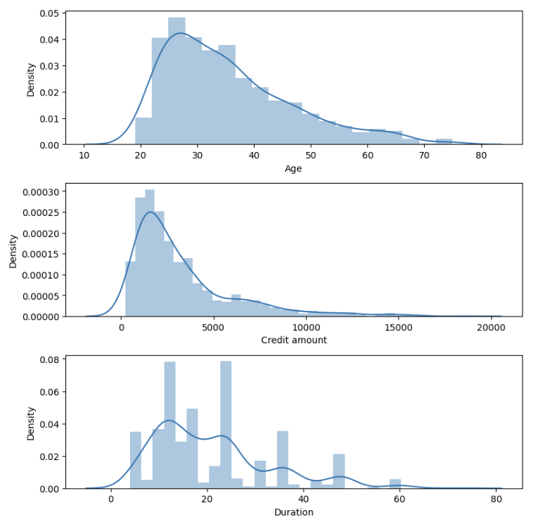
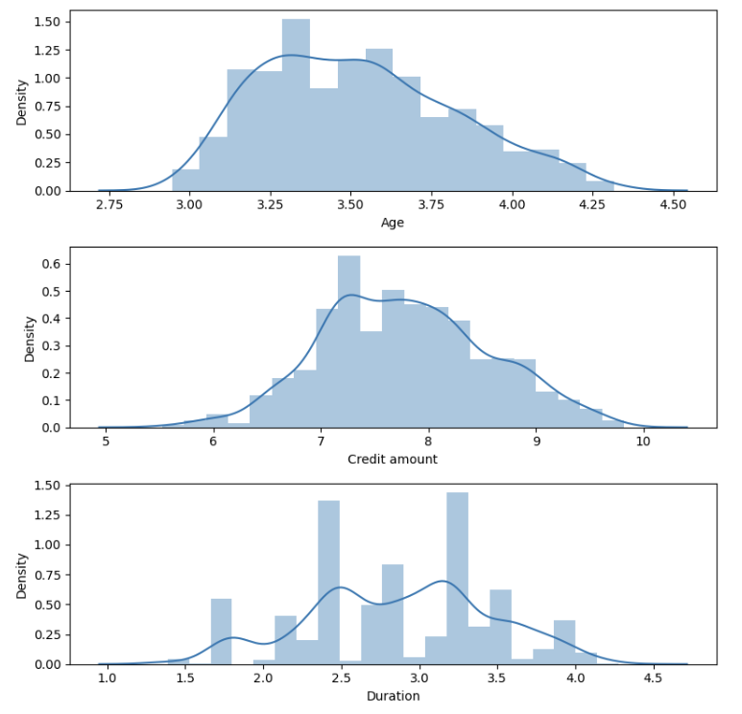
Clustering with kmeans
Selecting columns for clusterisation with Kmeans = ["Age","Credit amount", "Duration"]
The histogram plot result above is right-skewed. To produce better results, it is necessary to remove the skewed with logarithmic transformation.
The Skewness has been eliminated

Slide 9
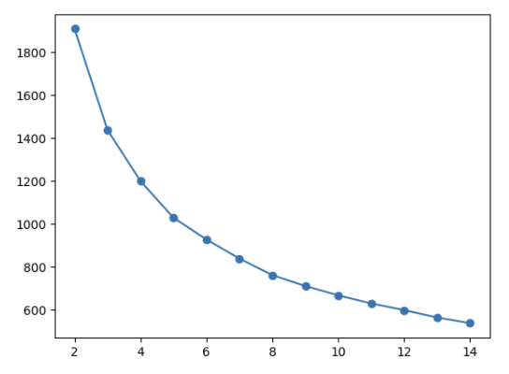
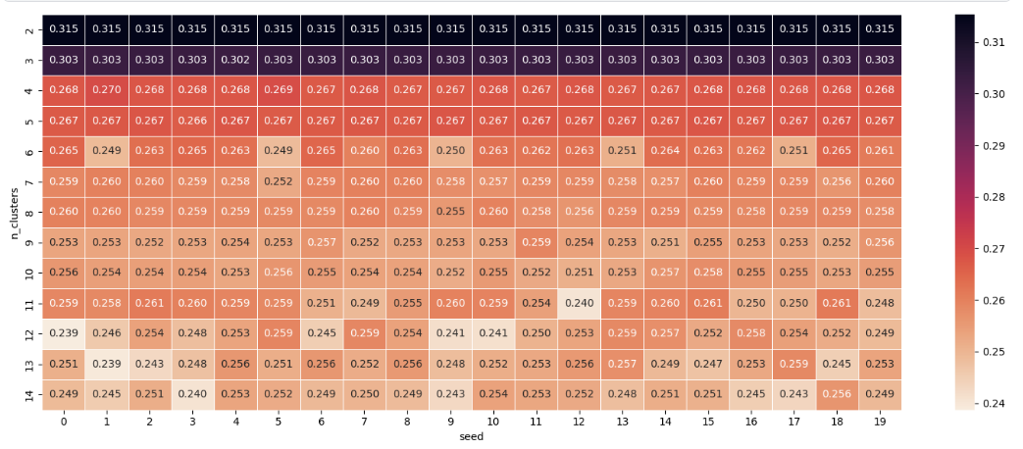
Clustering with kmeans
Centering and Scaling with check how inertia changes for various numbers of clusters
selecting the best parameters for the K-Means model based on the Silhouette Score
The highest scores are for clusters 2 and 3 and are relatively insensitive to seed.
Inertia decrease with increasing number of clusters
this method provides an assessment of cluster separation and placement of observations within their respective clusters.

Slide 10
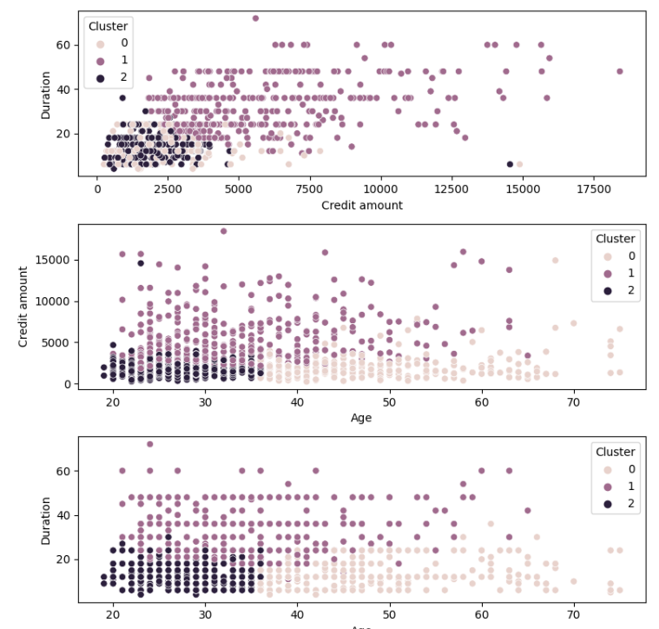
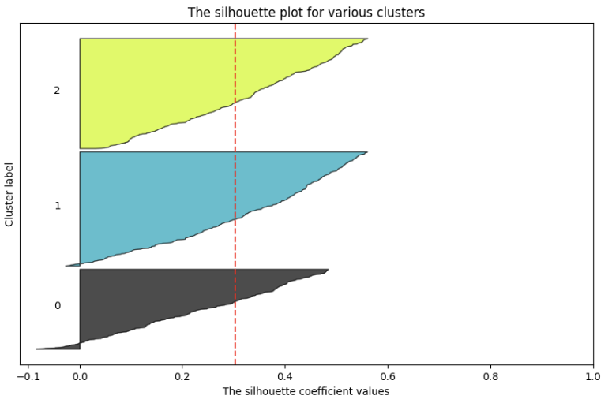
Clustering with kmeans
silhouette graph for 3 clusters in order to visually depict fit of each point within its own cluster
showing clusters on the scatter plot.
The plot above shows three clusters formed. The second and third clusters show relatively clear cluster separation, but not so clear in the first cluster.

Slide 11
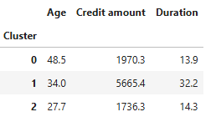
Clustering with kmeans
Summary
Cluster 0 – lower mean of credit amount, short duration, older customers
Cluster 1 – high mean of credit amount, long duration, middle-aged customers
Cluster 2 - lower mean of credit amount, short duration, young customers

Slide 12
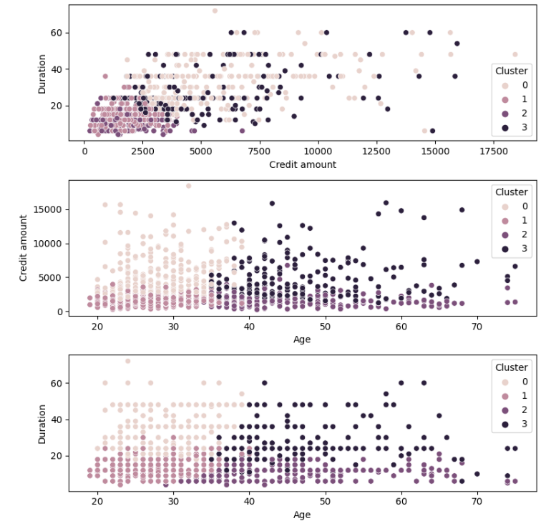
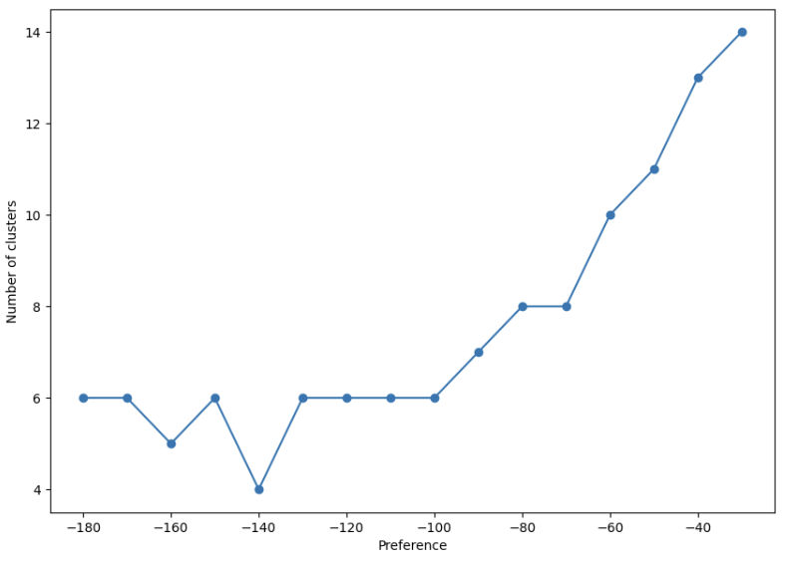
Clustering with Affinity Propagation
In this algorithm there are two relevant parameters: preference and dumping. That is, we do not specify the number of clusters at the beginning, the algorithm itself chooses the number. I will fix dumping and check the number of clusters based on the preference parameter.
evaluate the influence of preference parameters
As the preference parameter value decreases, the number of clusters also decreases and the level for very small preference values. I will use the four cluster option.

Slide 13
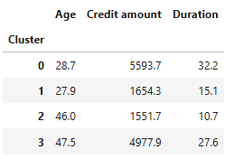
Clustering with Affinity Propagation
Summary
Cluster 0 – high mean of credit amount, long duration, younger customers
Cluster 1 – low mean of credit amount, short duration, younger customers
Cluster 2 - low mean of credit amount, short duration, older customers
Cluster 3 - high mean of credit amount, middle-time duration, older customers

